Slide 1


WhatsApp Chat Analysis Project
This project presents a comprehensive tool for analyzing WhatsApp chat data, built with Python and Streamlit.
by Deeptimaan Krishna Jadaun

Slide 2

Introduction
1
Project Title
2
Purpose
3
Technology
WhatsApp Chat Analysis.
A comprehensive tool for analyzing WhatsApp chat data.
Built with Python and Streamlit.

Slide 3
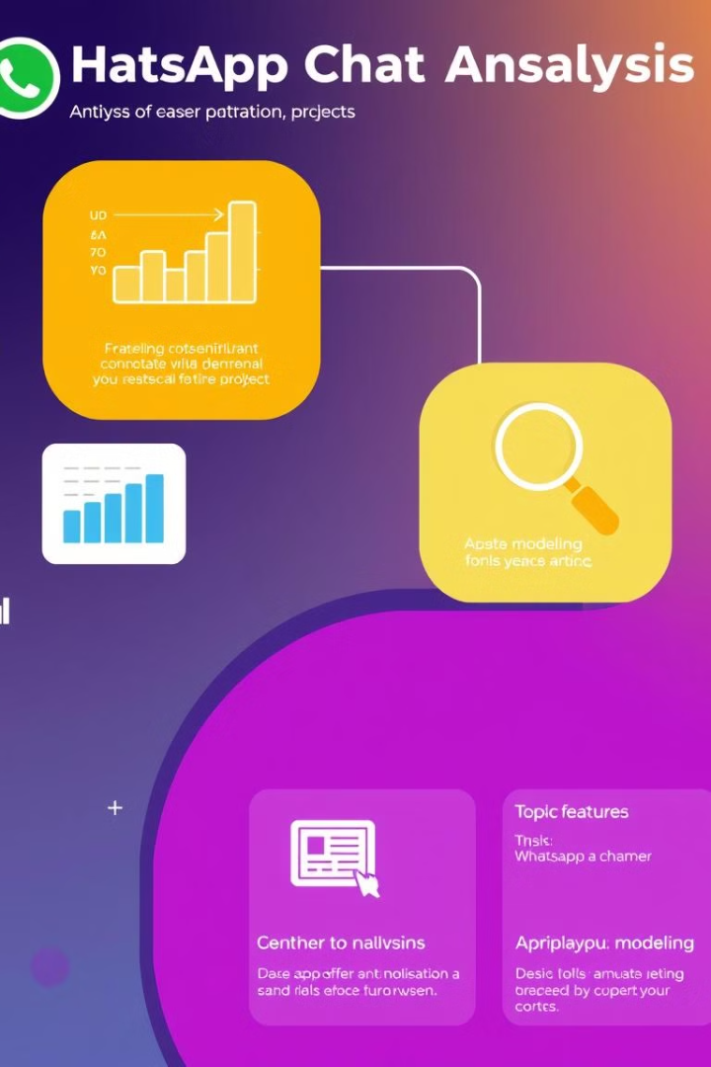
Project Overview
Chat Data Parsing
Sentiment Analysis
Extracts and visualizes chat data.
Analyzes the emotional tone of messages.
Topic Modeling
Identifies key themes and topics in conversations.

Slide 4
Technology Stack
Frontend
Backend
Data Processing
Streamlit.
Python.
Pandas, NumPy.

Slide 5
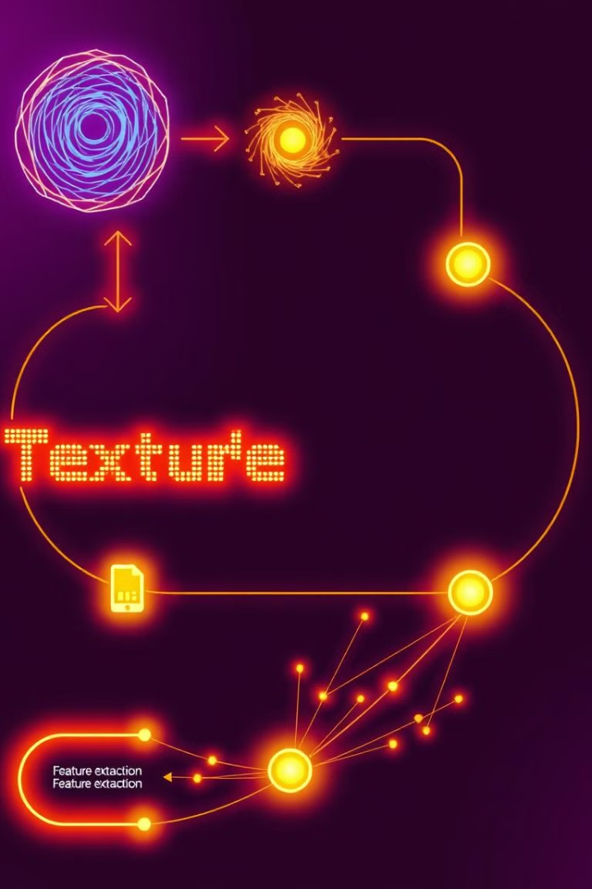
Data Processing & Analysis Methods
1
Data Parsing
Extracts messages using regular expressions.
2
Text Processing
Tokenization, stopword removal, lemmatization.
3
Named Entity Recognition
Identifies entities like people, places, and organizations.

Slide 6
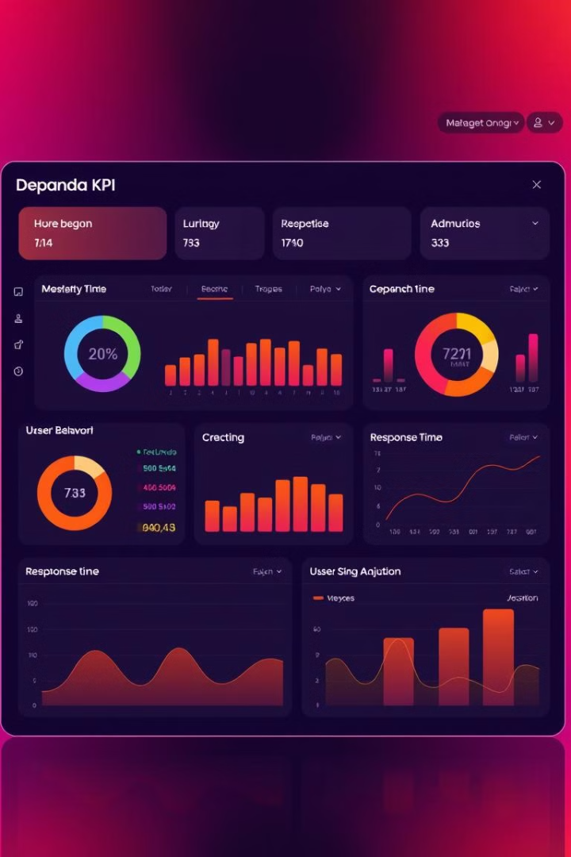
Analysis Features - Part 1
Message Statistics
User Behavior Analysis
Messages per user, daily/hourly activity patterns, response time analysis.
Active hours visualization, user interaction patterns, message length distribution.

Slide 7
Analysis Features - Part 2
Sentiment Analysis
Topic Modeling
TextBlob implementation, polarity scoring, sentiment trends over time.
LDA (Latent Dirichlet Allocation), topic visualization, keyword extraction.

Slide 8
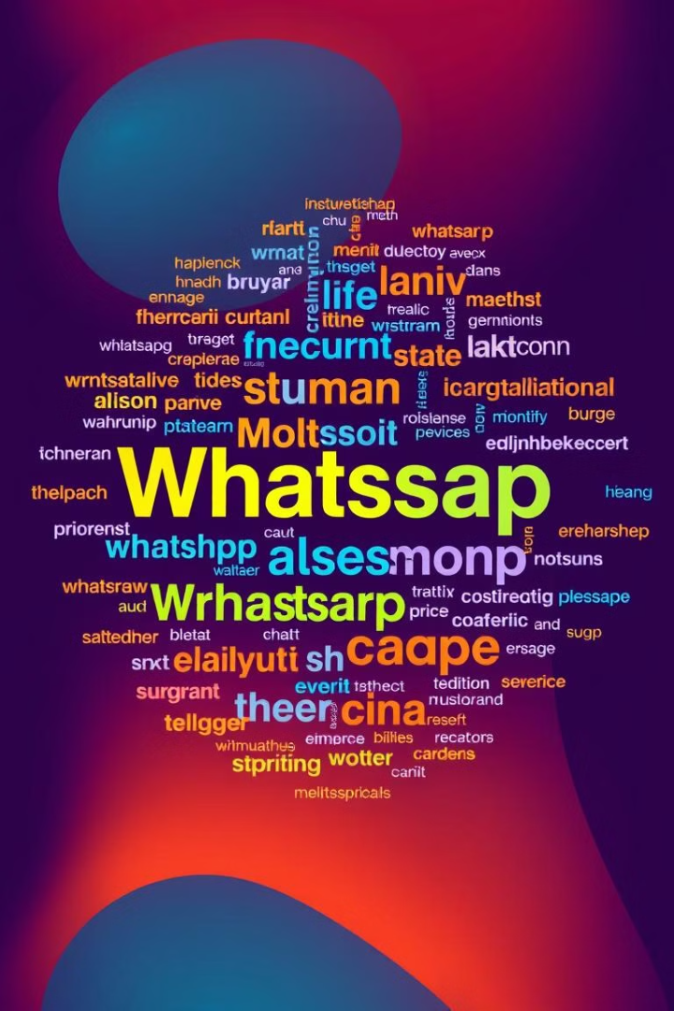


Analysis Features - Part 3
Emoji Analysis
Word Cloud Generation
Frequency counting, user preferences, temporal patterns.
Common words visualization, topic-based clouds, user-specific clouds.

Slide 9
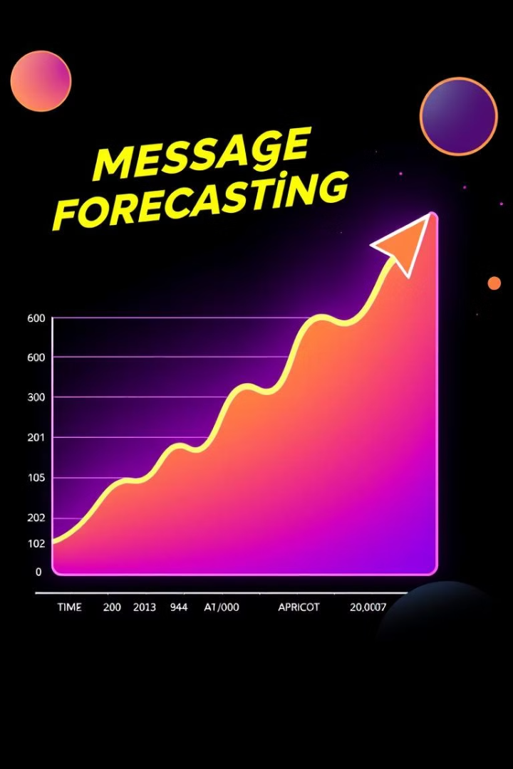


Forecasting & Alerts
Message Forecasting
Linear Regression model, time series analysis, future trend prediction.
Alert System
Keyword-based alerts, sentiment-based triggers, custom alert configuration.

Slide 10

Interactive Features
Mystery User Challenge
Mood Meter
Message guessing game, Chat Wordle implementation, user engagement metrics.
Daily sentiment tracking, emotional trend analysis, group dynamics visualization.

Slide 11
Technical Implementation
Data Pipeline
Analysis Pipeline
Upload files, parse messages, preprocess data.
Sentiment analysis, topic modeling, time series analysis.
Extract key features for analysis.
Visualize the data using Streamlit for insights.

Slide 12
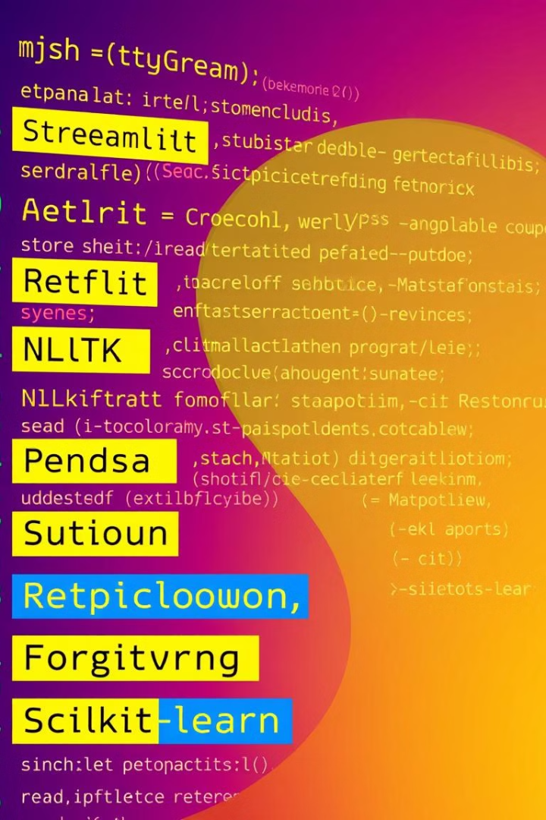
Libraries & Dependencies
1
Streamlit
2
NLTK
Interactive web app framework for visualization.
Natural Language Toolkit for text processing and analysis.
3
Gensim
4
TextBlob
Topic modeling library for uncovering hidden topics.
Simplified NLP library for sentiment analysis and more.

Slide 13

To download the App plz Scan this QR code

